Slide 1
ET 8403
INFORMATION THEORY AND CODING
Dr. Joseph.S.Salawa
0754556575

Slide 2
Introduction
What is Information Theory?
IT is a branch of math (a strictly deductive system). (C. Shannon)
General statistical concept of communication. (N. Wiener, What is IT?)
It was build upon the work of Shannon (1948)
It answers to two fundamental questions in Communications Theory:
What is the fundamental limit for information compression?
What is the fundamental limit on information transmission rate over a communications channel?

Slide 3
Digital Communications Systems
The fundamental problem of communication is that of reproducing at one point either exactly or approximately a message selected at another point. (Claude Shannon: A Mathematical Theory of Communications, 1948)

Slide 4
Source
Source Coder: Convert an analog or digital source into bits.
Channel Coder: Protection against errors/erasures in the channel.
Modulator: Each binary sequence is assigned to a waveform
Channel: Physical Medium to send information from transmitter to receiver. Source of randomness.
Demodulator, Channel Decoder, Source Decoder, Sink.
Modulator + Channel = Discrete Channel.

Slide 5
Model of a Digital Communication System
Message
e.g. English symbols
Encoder
e.g. English to 0,1 sequence
Information
Source
Coding
Communication
Channel
Destination
Decoding
Can have noise
or distortion
Decoder
e.g. 0,1 sequence to English

Slide 6

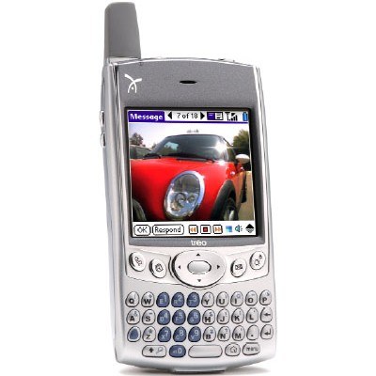
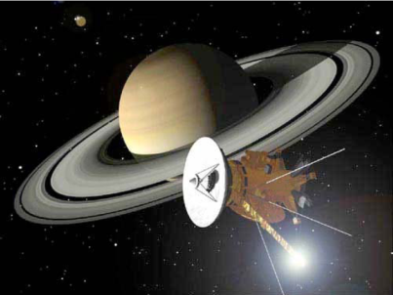


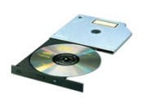
Communication Channel Includes

Slide 7
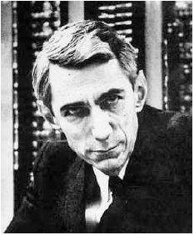
Shannon’s Definition of Communication
“The fundamental problem of communication is that of reproducing at one point either exactly or approximately a message selected at another point.”
“Frequently the messages have meaning”
“... [which is] irrelevant to the engineering problem.”

Slide 8
Shannon Wants to…
Shannon wants to find a way for “reliably” transmitting data throughout the channel at “maximal” possible rate.
Information
Source
Coding
Communication
Channel
Destination
Decoding
For example, maximizing the speed of ADSL @ your home

Slide 9
Shannon’s Vision
Data
Source
Encoding
Channel Encoding
Channel
User
Source Decoding
Channel Decoding

Slide 10
Example: Disk Storage
Data
Zip
Add CRC
Channel
User
Unzip
Verify CRC

Slide 11
In terms of Information Theory Terminology
Zip
Source
Encoding
=
Data Compression
Unzip
Source Decoding
=
Data Decompression
Add CRC
Channel Encoding
=
Error Protection
Verify CRC
Channel Decoding
=
Error Correction

Slide 12
Example: VCD and DVD
Moive
MPEG
Encoder
RS Encoding
CD/DVD
TV
MPEG Decoder
RS Decoding
RS stands for Reed-Solomon Code.

Slide 13

Example: Cellular Phone
Speech Encoding
CC Encoding
Channel
Speech Decoding
CC Decoding
GSM/CDMA
CC stands for Convolutional Code.

Slide 14
Example: WLAN IEEE 802.11b
Data
Zip
CC Encoding
Channel
User
Unzip
CC Decoding
IEEE 802.11b
CC stands for Convolutional Code.

Slide 15
Shannon Theory
The original 1948 Shannon Theory contains:
Measurement of Information
Source Coding Theory
Channel Coding Theory

Slide 16
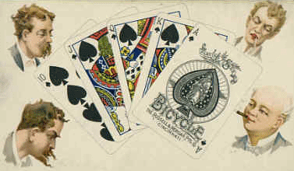
Measurement of Information
Shannon’s first question is
“How to measure information
in terms of bits?”
= ? bits
= ? bits

Slide 17
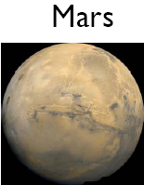
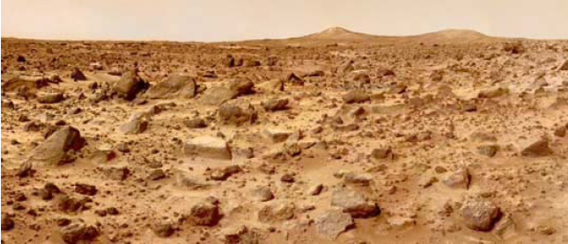
Or this…
= ? bits
= ? bits

Slide 18
All events are probabilistic!
Using Probability Theory, Shannon showed that there is only one way to measure information in terms of number of bits:
called the entropy function

Slide 19
For example
Tossing a dice:
Outcomes are 1,2,3,4,5,6
Each occurs at probability 1/6
Information provided by tossing a dice is

Slide 20
Wait! It is nonsense!
The number 2.585-bits is not an integer!!
What does you mean?

Slide 21
Shannon’s First Source Coding Theorem
Shannon showed:
“To reliably store the information generated by some random source X, you need no more/less than, on the average, H(X) bits for each outcome.”

Slide 22
Meaning:
If I toss a dice 1,000,000 times and record values from each trial
1,3,4,6,2,5,2,4,5,2,4,5,6,1,….
In principle, I need 3 bits for storing each outcome as 3 bits covers 1-8. So I need 3,000,000 bits for storing the information.
Using ASCII representation, computer needs 8 bits=1 byte for storing each outcome
The resulting file has size 8,000,000 bits

Slide 23
But Shannon said:
You only need 2.585 bits for storing each outcome.
So, the file can be compressed to yield size
2.585x1,000,000=2,585,000 bits
Optimal Compression Ratio is:

Slide 24

Let’s Do Some Test!
 | File Size | Compression Ratio
No Compression | 8,000,000 bits | 100%
Shannon | 2,585,000 bits | 32.31%
Winzip | 2,930,736 bits | 36.63%
WinRAR | 2,859,336 bits | 35.74%

Slide 25
But With 50 Years of Hard Work
We have discovered a lot of good codes:
Hamming codes
Convolutional codes,
Concatenated codes,
Low density parity check (LDPC) codes
Reed-Muller codes
Reed-Solomon codes,
BCH codes,
Finite Geometry codes,
Cyclic codes,
Golay codes,
Goppa codes
Algebraic Geometry codes,
Turbo codes
Zig-Zag codes,
Accumulate codes and Product-accumulate codes,
…
We now come very close to the dream Shannon had 50 years ago! ☺

Slide 26

Nowadays…
Source Coding Theorem has applied to
Image
Compression
MPEG
Audio/Video
Compression
Data
Compression
Audio
Compression
MP3
Channel Coding Theorem has applied to
VCD/DVD – Reed-Solomon Codes
Wireless Communication – Convolutional Codes
Optical Communication – Reed-Solomon Codes
Computer Network – LT codes, Raptor Codes
Space Communication

Slide 27
Shannon's information theory deals with limits on data compression (source coding) and reliable data transmission (channel coding) { How much can data can be compressed?
{ How fast can data be reliably transmitted over a noisy channel?
Two basic \point-to-point" communication theorems (Shannon 1948)
{ Source coding theorem: the minimum rate at which data can be compressed losslessly is the entropy rate of the source
{ Channel coding theorem: The maximum rate at which data can be reliably transmitted is the channel capacity of the channel

Slide 28
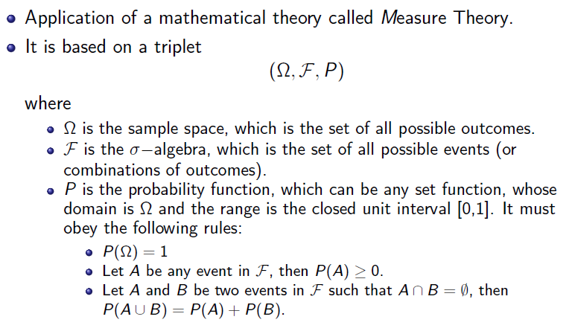
Axiomatic Approach

Slide 29
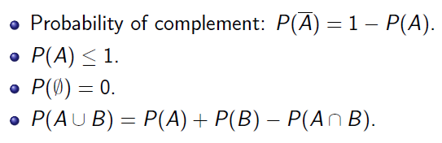

Slide 30
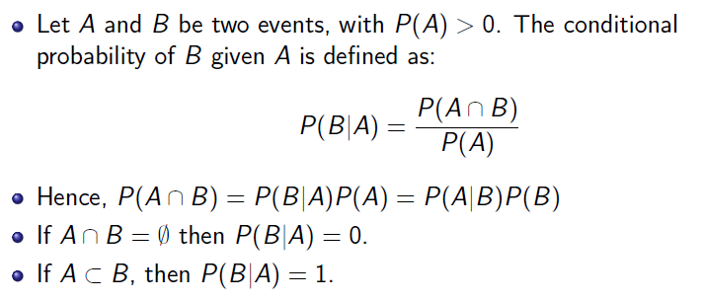
Conditional Probability

Slide 31
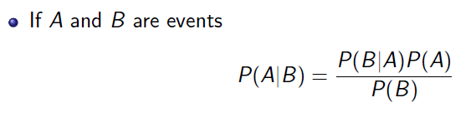
Bayes Rule

Slide 32
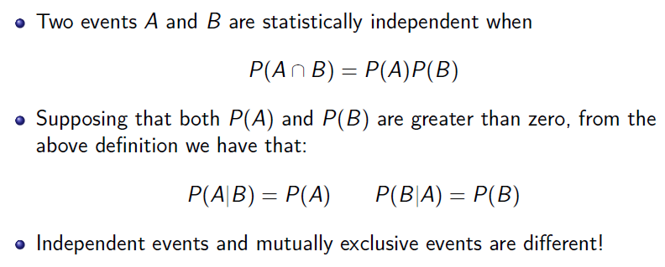
Independence between Events

Slide 33
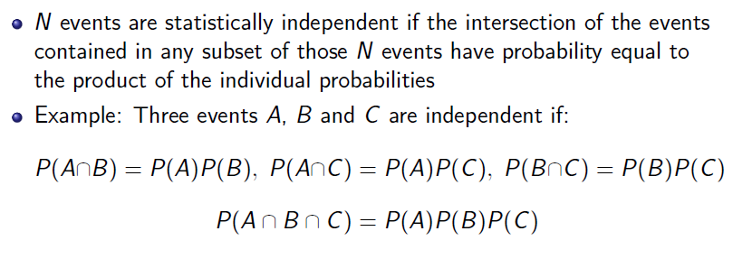

Slide 34

What is Information?

Slide 35
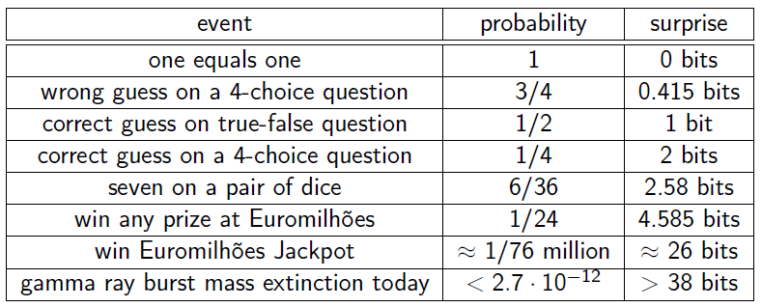

Slide 36
Entropy ??
NEXT LECTURE
Thank you

